Slide 1
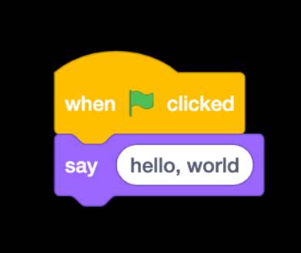
Decision Making
IF-Else
If- Else If
Switch
Sumaiyah Zahid

Slide 2
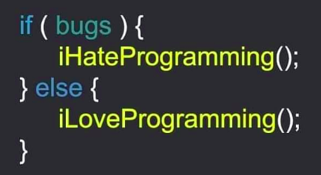
Decisions! Decisions!
We use relational and logical operators for decision making.
Works on 1 and 0
1 means True
0 means False

Slide 3
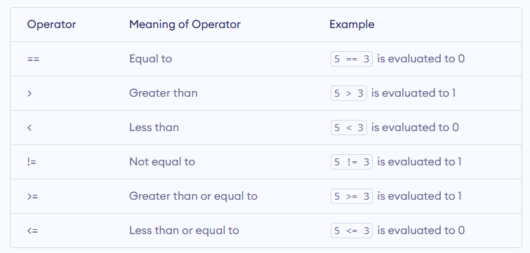
Relational Operators

Slide 4
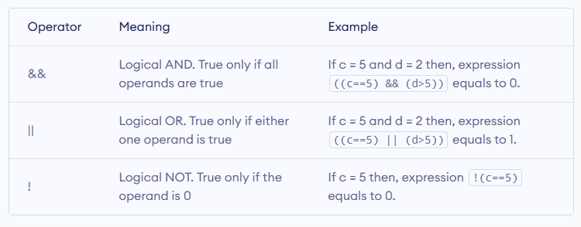
Logical Operators

Slide 5
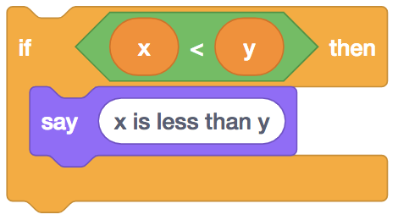
if (x < y) {
printf("x is less than y\n");
}

Slide 6
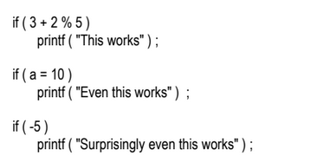
if ( this condition is true )
execute this statement ;
if ( expression )
statement ;

Slide 7

What would be the output?
#include<stdio.h>
int main( )
{
int a = 300, b, c ;
if ( a >= 400 )
{
b = 300 ;
c = 200 ;
printf ( "\n%d %d", b, c ) ;
}
}

Slide 8
What would be the output?
#include<stdio.h>
int main( )
{
int a = 500, b, c ;
if ( a >= 400 )
{
b = 300 ;
c = 200 ;
printf ( "\n%d %d", b, c ) ;
}
}

Slide 9
What would be the output?
#include<stdio.h>
int main( )
{
int a = 300, b, c, d=300 ;
if ( a >= 400 || d<500 )
{
b = 300 ;
c = 200 ;
printf ( "\n%d %d", b, c ) ;
}
}

Slide 10
What would be the output?
#include<stdio.h>
int main( )
{
int a = 300, b, c, d=300 ;
if ( a >= 400 && d<500 )
{
b = 300 ;
c = 200 ;
printf ( "\n%d %d", b, c ) ;
}
}

Slide 11
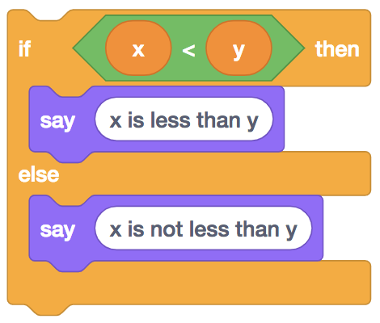
if (x < y) {
printf("x is less than y\n");
}
else
{ printf("x is not less than y\n");
}

Slide 12
What would be the output?
#include<stdio.h>
int main( )
{
int x = 3, y = 5 ;
if ( x == 3 )
{ printf ( "\n%d", x ) ; }
else
{ printf ( "\n%d", y ) ; }
}

Slide 13
Practice Exercise
Write a program to check whether a triangle is valid or not, when the three angles of the triangle are entered through the keyboard. A triangle is valid if the sum of all the three angles is equal to 180 degrees.

Slide 14
Home Assignment
Any integer is input through the keyboard. Write a program to find out whether it is an odd number or even number.
Any year is input through the keyboard. Write a program to determine whether the year is a leap year or not. (Hint: Use the % (modulus) operator)
A five-digit number is entered through the keyboard. Write a program to obtain the reversed number and to determine whether the original and reversed numbers are equal or not.

Slide 15
Life is an all
“If-ELSE”
Statements
“Sumaiyah Zahid”

Slide 16

You can pick one Ice-cream only
Vanilla vs chocolate ?

Slide 17
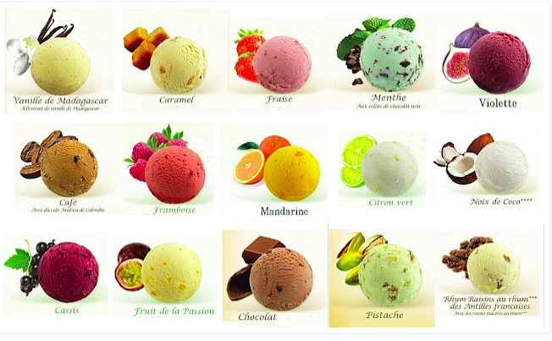
You can pick one Ice-cream only

Slide 18
If Else vs if Else IF
Only 1 block is run in If Else or either in If Else If.

Slide 19
#include <stdio.h>
int main()
{
Char day='W';
if (day=='M' || day =='T' || day =='S')
{
printf("Programming Class will be there.");
}
else
{
printf("NO class is scheduled! Hurray!");
}
return 0;
}

Slide 20
#include <stdio.h>
int main()
{
char day='W';
if (day=='M' || day =='T' || day =='S')
{
printf("Programming Class will be there.");
}
else if (day=='W' || day =='F’|| day =='t’) // small t for Thursday
{
printf("No class is scheduled! Hurray!");
}
else
{
printf("Yay! It’s Sunday");
}
return 0;}

Slide 21
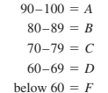
Practice Problem
Write a program which asks a user about his marks and calculates a student’s letter grade on the following condition.

Slide 22
#include <stdio.h>
int main()
{
int score;
printf("Enter Your score: ");
scanf("%d",&score);
if (score<=100 && score >=90 )
{ printf("Your grade is A! Congratulations!"); }
else if (score<=89 && score >=80 )
{ printf("Your grade is B! Very Good!"); }
else if (score<=79 && score >=70 )
{ printf("Your grade is C! Keep Working Hard!"); }
else if (score<=69 && score >=60 )
{ printf("Your grade is D! You need to improve!"); }
else
{ printf("You need to work al ot"); }
return 0;}

Slide 23
Home Assignment
A library charges a fine for every book returned late. For first 5 days the fine is 50 paise, for 6-10 days fine is one rupee and above 10 days fine is 5 rupees. If you return the book after 30 days your membership will be cancelled. Write a program to accept the number of days the member is late to return the book and display the fine or the appropriate message.
Write a program to find the greatest of the three numbers entered through the keyboard.

Slide 24
Home Assignment
3. Write a program that reads the temperature in centigrade and display a suitable message according to the temperature state below:
● Temp < 0 then Freezing weather
● Temp 0-10 then Very Cold weather
● Temp 10-20 then Cold weather
● Temp 20-30 then Normal in Temp
● Temp 30-40 then It’s Hot
● Temp >=40 then It’s Very Hot

Slide 25
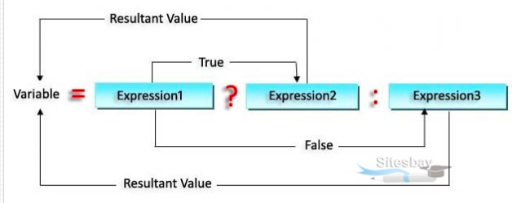
Ternary Operator
result = binaryCondition ? valueReturnedIfTrue : valueReturnedIfFalse;

Slide 26
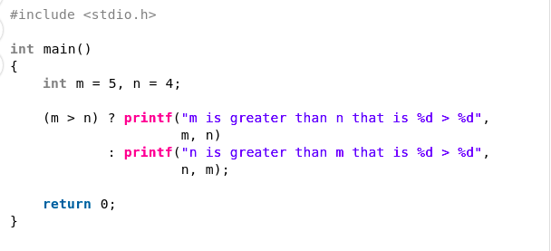
Ternary Operator

Slide 27
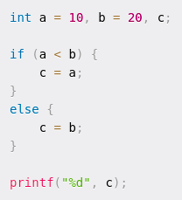
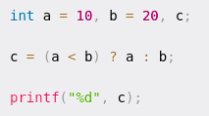
Ternary Operator

Slide 28
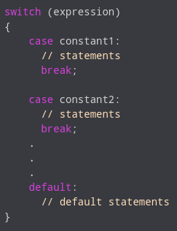
Switch case
Similar like if-else if.
In each case the value of item must be a constant, variables are not allowed.

Slide 29
//program to create a simple calculator
#include <stdio.h>
int main()
{ char operator;
int n1, n2;
printf("Enter an operator (+, -, *, /): ");
scanf("%c", &operator);
printf("Enter two operands: ");
scanf("%d %d",&n1, &n2);
switch(operator)
{
case '+':
printf("%d + %d = %d",n1, n2, n1+n2);
break;
case '-':
printf("%d - %d = %d",n1, n2, n1-n2);
break;

Slide 30
case '*':
printf("%d * %d = %d",n1, n2, n1*n2);
break;
case '/':
printf("%d / %d = %d",n1, n2, n1/n2);
break;
// operator doesn't match any case constant +, -, *, /
default:
printf("Error! operator is not correct");
}
return 0;
}

Slide 31
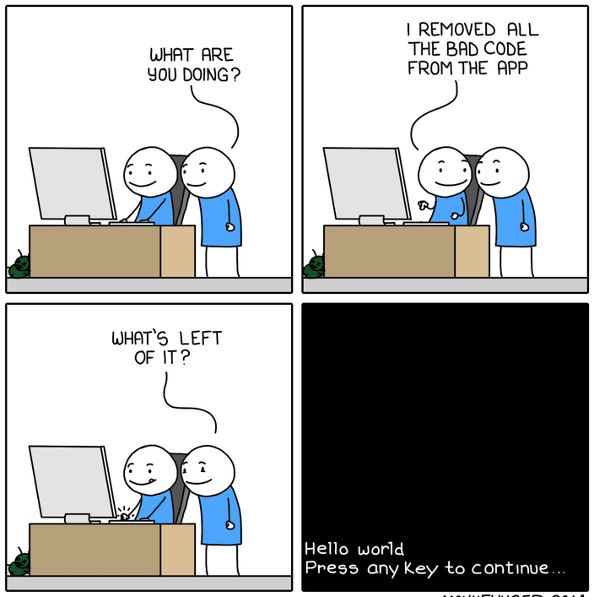
Practise Exercise
You are searching for a department in a university and you’re asked to select a school from a choice of three schools namely
School of Computer Science
School of Business
School of Engineering
Read an integer value for the selection of department. Implement this using switch case.

Slide 32
Switch case
You can put the cases in any order you please.
If there are multiple statements to be executed in each case there is no need to enclose them within a pair of braces (unlike if, and else).
The break is needed if you want to terminate the switch after execution of one choice. Otherwise the next case would get evaluated.
We can also have null statements by just including a : or let the switch statement fall through by omitting any statements.

Slide 33
#include <stdio.h>
int main()
{ char letter;
int vowels=0, consonants=0;
printf("Enter a letter");
scanf("%c", &letter);
switch(letter)
{
case 'A':
case 'E':
case 'I':
case 'O':
case 'U': vowels++;
break;
default: consonants++;
}
return 0;
}

Slide 34
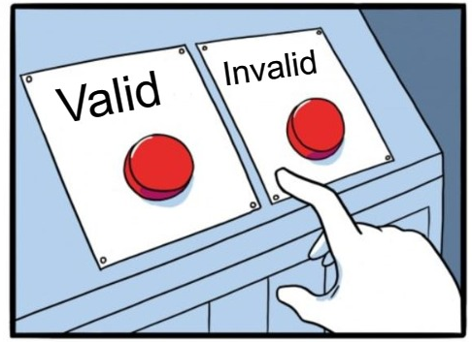
Valid and Invalid
Not allowed: Legal expressions:
case i <= 20: switch ( i + j * k )
case 2.5: switch ( 23 + 45 % 4 * k )
case a+b: switch ( a < 4 && b > 7 )

Slide 35
#include <stdio.h>
int main()
{ int i=0, j=2, k=1;
switch(i+j*k)
{
case 0: printf("Answer is zero");
break;
case 1: printf("Answer is one");
break;
case 2: printf("Answer is two");
break;
default: printf("No Answer");
}
return 0;
}

Slide 36
#include <stdio.h>
int main()
{ int i=0, j=2, k=1;
switch(i<j || i<k)
{
case 0: printf("Answer is zero");
break;
case 1: printf("Answer is one");
break;
default: printf("No Answer");
}
return 0;
}

Slide 37
#include <stdio.h>
int main()
{ int i=2021;
switch(i%4)
{
case 0: printf("It’s a leap year");
break;
case 1: printf("It’s not a leap year");
break;
case 2: printf("It’s not a leap year");
break;
case 3: printf("It’s not a leap year");
break;
}
return 0;
}

Slide 38
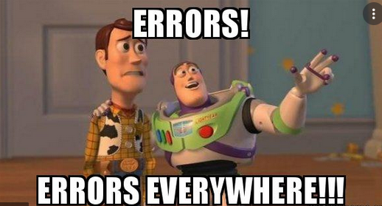
Home Assignment
Read an integer value. Assume it is the number of a month of the year, print out the name of that month using switch case.
Write a C program which reads an input integer 1-7 and prints day of week name using switch case.

Slide 39
Home assignment
3. Write a program which reads two integer values. If the first is less than the second, print the message up. If the second is less than the first, print the message down If the numbers are equal, print the message equal If there is an error reading the data, print a message containing the word Error. [use switch case only]
4. Must read https://www.geeksforgeeks.org/interesting-facts-about-switch-statement-in-c/

Slide 40
Nested Statements
switch (variable)
{
case ‘A’:
if (condition)
{}
break;
case ‘B’:
}

Slide 41
Practice Example
Make a simple calculator using switch case. Do these additional tasks inside the cases.
For + : if result > 100
print ( It’s a huge number)
For - : subtract the smaller number from the larger one
For * : check both numbers are even or odd
For / : Just do the division

Slide 42
Nested Switch Statements
switch (variable)
{
case ‘A’:
switch (variable 2):
{
case 1:
case 2:
}
break;
case ‘B’:
}

Slide 43
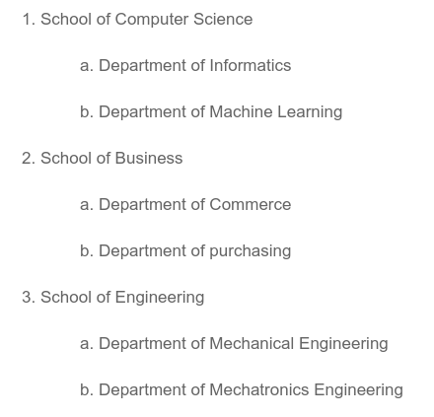
Practise Exercise
You are searching for a department in a university and you’re asked to select a school from a choice of schools namely. Make a program which prints a welcome message for each department.

Slide 44
Practice Example
Write a program which reads two integer values. If the first is less than the second, print the message up. If the second is less than the first, print the message down If the numbers are equal, print the message equal If there is an error reading the data, print a message containing the word Error. [use nested switch]

Slide 45
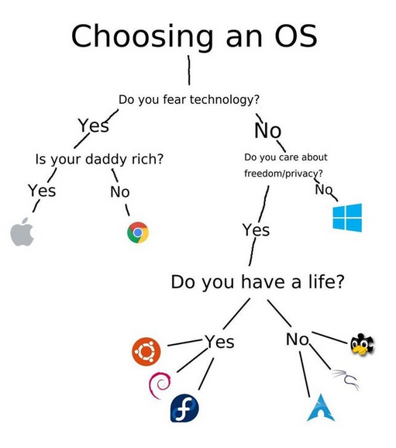
Nested If/Else
if(condition)
{ if(condition) {
switch(variable)
{
case 1:
Case 2:
}
}
else {}
}
else
{
if (condition){}
}

